Slide 1
Transfer Learning
Module 2

Slide 2
Transfer Learning
Transfer learning is a powerful technique used in Deep Learning. By harnessing the ability to reuse existing models and their knowledge of new problems, transfer learning has opened doors to training deep neural networks even with limited data.
The knowledge of an already trained machine learning model is transferred to a different but closely linked problem throughout transfer learning.
Because of the massive amount of CPU power required, transfer learning is typically applied in computer vision and natural language processing tasks like sentiment analysis.

Slide 3
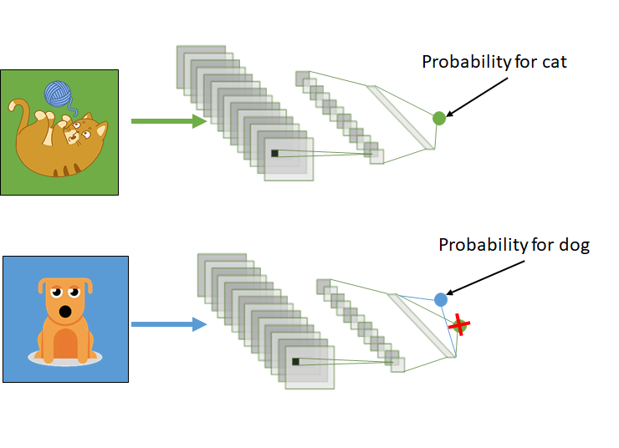

Slide 4
Pretrained Models –VGG16 and VGG19
The VGG (Visual Geometry Group) models, specifically VGG16 and VGG19, were introduced by the Visual Geometry Group at the University of Oxford. These models are known for their simplicity and uniform architecture, making them easy to understand and work with. They are widely used for image classification tasks.
Architecture
VGG16: VGG16 consists of 16 layers, including 13 convolutional layers and 3 fully connected layers.
VGG19: VGG19 has 19 layers, including 16 convolutional layers and 3 fully connected layers.

Slide 5
Convolutional Layer:
The convolutional layers in VGG networks use 3x3 filters with a stride of 1 and 'same' padding. This small filter size allows the network to capture fine-grained features.
Max-pooling layers with 2x2 filters and a stride of 2 are used to downsample the spatial dimensions.
Fully Connected Layers
After several convolutional and pooling layers, VGG networks have fully connected layers that serve as a classifier.
The final layer has as many neurons as the number of classes in the classification task.

Slide 6
Activation Function
ReLU (Rectified Linear Unit) is used as the activation function in all layers except the output layer.
Advantages:
VGG networks are known for their high performance on image classification tasks, especially when large amounts of labeled data are available.
Their uniform architecture simplifies model design.

Slide 7
Pretrained Model: ResNet50
ResNet (Residual Network) is a family of deep neural network architectures known for their ability to train very deep networks effectively. ResNet-50 is one of the variants, and it has 50 layers. The key innovation in ResNet is the introduction of residual connections, which allow the network to handle the vanishing gradient problem and enable training of extremely deep networks.
Residual Blocks:
In a residual block, the input to the block (identity mapping) is added to the output of the block. This introduces a shortcut connection.
The activation function is applied after the addition of the shortcut connection, allowing gradients to flow directly through the shortcut path.
ResNet-50 comprises several residual blocks, which are organized into convolutional layers.

Slide 8
Architecture
ResNet-50 consists of 50 layers, primarily organized into three types of residual blocks: 3 blocks with 64 filters, 4 blocks with 128 filters, and 6 blocks with 256 filters.
It is followed by global average pooling and a fully connected layer for classification.
Activation Function:
ReLU is used as the activation function within the residual blocks.
Advantages:
ResNet-50 and the ResNet family are known for their depth, which enables them to capture and learn complex features.
Residual connections facilitate training of very deep networks.

Slide 9
Thank You

